Slide 1
Probabilistic k^{m}-anonymity
(Efficient Anonymization of Large Set-valued Datasets)
Gergely Acs (INRIA)
gergely.acs@inria.fr
Jagdish Achara (INRIA)
jagdish.achara@inria.fr
Claude Castelluccia (INRIA)
claude.castelluccia@inria.fr

Slide 2
Overview
2
Motivation
Background: k^{m}-anonymity
Why k^{m}-anonymity is impractical?
Relaxation of k^{m}-anonymity: Probabilistic k^{m}-anonymity
How to anonymize to have probabilistic k^{m}-anonymity?
Performance evaluation
Conclusions
Notes:
Important: users are present in the intersection of the datasets!!!
US: HIPAA deals only with re-identifiability and prescribes best-practices (remove PIDS, how to generalize birth dates, etc.)

Slide 3
De-identification
3
Personal data is any information relating to an identified or identifiable individual (EU Directive 95/46/EC)
De-identification breaks links between individuals’ identity and their data (records)
Regulations apply only to personal data!
De-identified data is non-personal data and hence out of the regulation
NOTE: de-identification does NOT include the control of (sensitive) attribute inference
Notes:
Important: users are present in the intersection of the datasets!!!
US: HIPAA deals only with re-identifiability and prescribes best-practices (remove PIDS, how to generalize birth dates, etc.)

Slide 4
Set-valued data
4
Rec # | Data
1 | {Item 2, Item 3}
2 | {Item 1, Item 3, Item n}
… | …
Rec # | Item 1 | Item 2 | Item 3 | … | Item n
1 | 0 | 1 | 1 | … | 0
2 | 1 | 0 | 1 | … | 1
… | … | … | … | … | …
No direct Personal ID in the dataset (e.g., phone numbers)
Each user has a subset of items (e.g., visited locations, watched movies, purchased items, etc.)
High-dimensional and sparse data!
Y.-A. de Montjoye et al. Unique in the crowd: The privacy bounds of human mobility. Nature, March 2013.
Y.-A. de Montjoye et al. Unique in the shopping mall: On the reidentifiability of credit card metadata. Science, January 2015.
Notes:
Full CDR is more detailed: includes the id of the receiver, the call duration, etc.

Slide 5
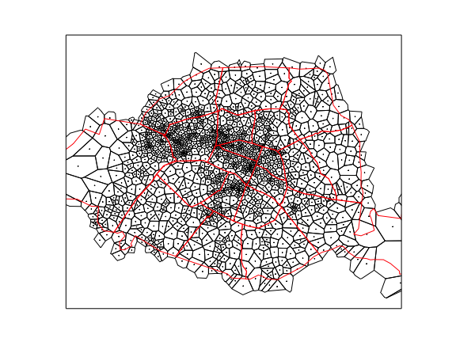
Privacy test: Location uniqueness
5
Rec # | Data
1 | {Tower 2, Tower 3}
2 | {Tower 1, Tower 3, Tower 5}
… | …
Derived from Call Data Records
4,427,486 users
1303 towers (i.e., locations)
01/09/2007 – 15/10/2007
Mean tower # per user: 11.42
(std.dev: 17.23)
Max. tower # user: 422

Slide 6
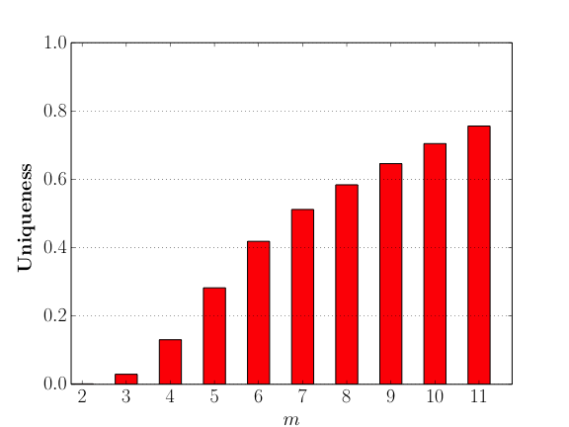
Privacy test: Location uniqueness
6
If the adversary knows m towers of a user, what is the probability that the user is the only one who have these towers in the dataset?
Similar study:
Y.-A. de Montjoye, C. A. Hidalgo, M. Verleysen, and V. D. Blondel. Unique in the crowd: The privacy bounds of human mobility. Scientific Reports, Nature, March 2013.
Notes:
- arbitrary external knowledge => Perfect if data is shared to the public!

Slide 7
Background: k^{m}-anonymity
7
For ANY m items, there are at least k users who have these items
  if m equals the maximum item number per user, then k^{m} is equivalent to k-anonymity
  However, k-anonymity suffers from the curse of dimensionality^{[1]} (i.e., very bad utility for high-dimensional, sparse data)
Rationale of k^{m}-anonymity: adversary is unlikely to know all the items of a user
Allows larger utility by applying fewer generalizations (aggregations)
[1] C. C. Aggarwal, On K-anonymity and the Curse of Dimensionality, VLDB, 2005
Notes:
- arbitrary external knowledge => Perfect if data is shared to the public!

Slide 8
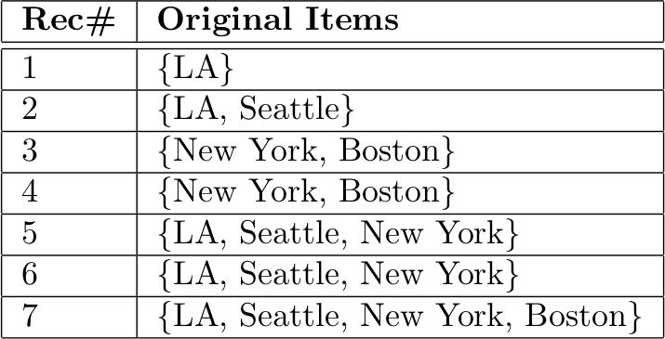
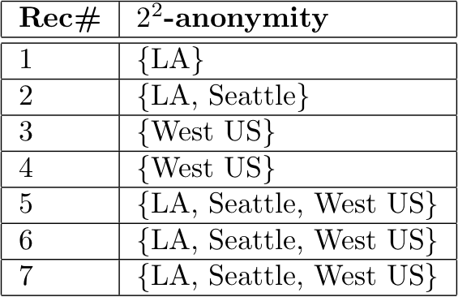

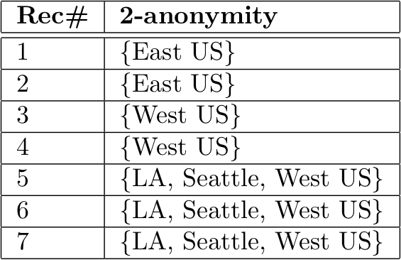
Example: k vs. k^{m}-anonymity
8
Notes:
- arbitrary external knowledge => Perfect if data is shared to the public!

Slide 9
Problem of k^{m}-anonymity
9
  Verifying k^{m}-anonymity can have exponential complexity in m ^{[1]}
    ➔ impractical if m is large (typically when m ≥ 5)
The exact speed depends on the structure of the generalization hierarchy and the dataset itself^{[1]}
➔ DOES NOT WORK FOR MANY REAL-WORLD DATASETS!
[1] M. Terrovitis, N. Mamoulis, P.Kalnis, Privacy-preserving anonymization of set-valued data, VLDB, 2008
Notes:
- arbitrary external knowledge => Perfect if data is shared to the public!

Slide 10
Probabilistic k^{m}-anonymity
10
For ANY m items, there are at least k users who have these items with probability at least p
  where p > 0.9, and typically should be around 0.99 or 0.999
Intuition: instead of checking all possible m items, we select randomly some of them from the dataset, and check k-anonymity of only these samples!
  ➔ we have k-anonymity for ANY randomly selected m items with large probability (based on sampling theorems)!
How to sample these m items?
How many samples are needed?
Notes:
- arbitrary external knowledge => Perfect if data is shared to the public!

Slide 11
How to sample m-itemsets?
11
Naïve approach:
1. Sample a record
2. Sample m items from this record
Biased towards selecting more popular itemsets!
(e.g., popular places in location data)
However, adversary may learn unpopular items easily
e.g., home address is not necessarily popular…
Our approach is more general:
Select among all m-itemsets uniformly at random using a fast-mixing Markov chain
Adversary can learn any m-itemset with equal probability!
Notes:
- arbitrary external knowledge => Perfect if data is shared to the public!

Slide 12

How many samples?
12
From the Chernoff-Hoeffding bound:
to have k^{m}-anonymity with probability p
Independent from m, the dataset size, and the number of all items!
p | N
0.99 | ≈ 60 K
0.999 | ≈ 5 M
1 | ∞
Notes:
- arbitrary external knowledge => Perfect if data is shared to the public!

Slide 13

Anonymization
13
INPUT: p – probability, k,m – privacy parameters, D – dataset
SAMPLING: Pick (uniformly at random) a single m-itemset from D using MCMC sampling
IF the sample does NOT satisfy k-anonymity
GENERALIZE an item in the sample such that generalization error is minimized (e.g., average cell size in location data)
REPEAT the above steps until consecutive samples satisfy k-anonymity
AMPLIFY UTILITY: Execute the above algorithm multiple times and select the one which has the least generalization error
Notes:
- arbitrary external knowledge => Perfect if data is shared to the public!

Slide 14



Running complexity
14
The required number of samples which must satisfy k-anon. is
For each sample, the Markov chain sampling runs in
The maximum number of generalizations is the number of possible items which is
Hence, the total complexity is
➔ polynomial in the number of records |D|, number of possible items |I|, m, and probability p
Notes:
- arbitrary external knowledge => Perfect if data is shared to the public!

Slide 15
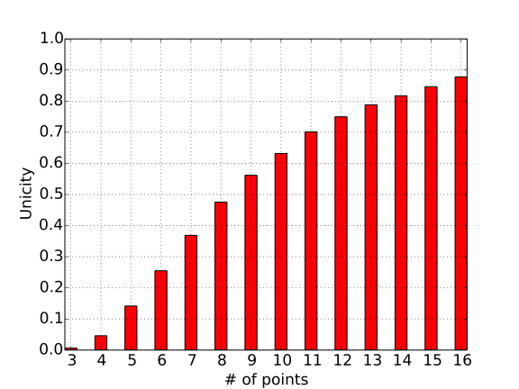
Performance evaluation:
Privacy guarantee
15
  RECALL: a user has fewer than 11 visited towers on average
We can have different privacy guarantee (i.e., k, p) for different m!
In the evaluation:
  when m ≤ 4: k is 10 or 20, p = 1 (rationale: too easy to learn fewer than 4 locations)
  when m ≥ 5: k is 10 or 20, p is 0.99 or 0.999 or 0 (no guarantee)
Execution time: couple of hours in all cases (dominated by p = 1)
➔ 1 ≤ m ≤ 11
Notes:
- arbitrary external knowledge => Perfect if data is shared to the public!

Slide 16
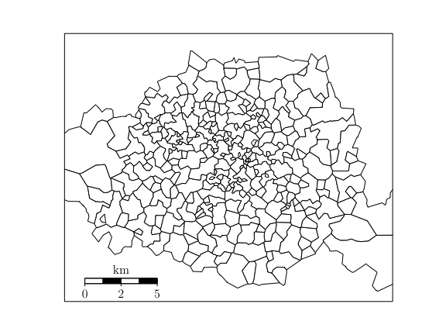
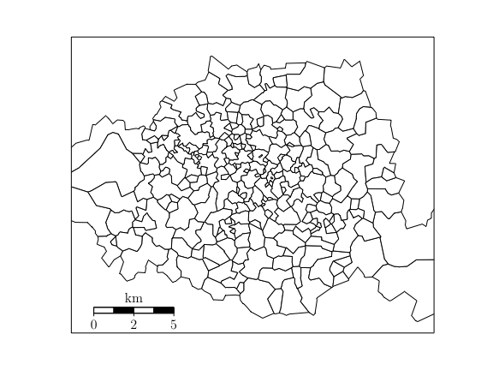
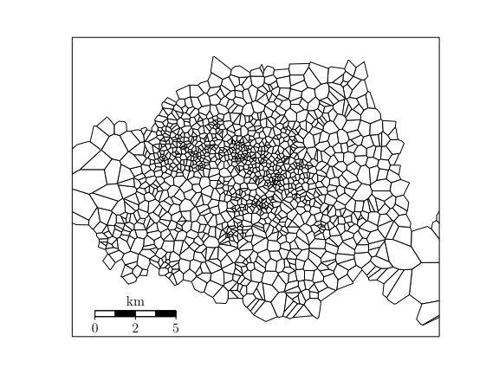
Performance evaluation
16
Privacy GOAL 1:
if 1 ≤ m ≤ 4: 20^{m}-anonymity with prob. 1
if m = 5, 20^{m}-anonymity with prob. p
if m ≥ 5, p = 0 (no guarantee)
p=.99
Original:
p=.999
Notes:
- arbitrary external knowledge => Perfect if data is shared to the public!

Slide 17
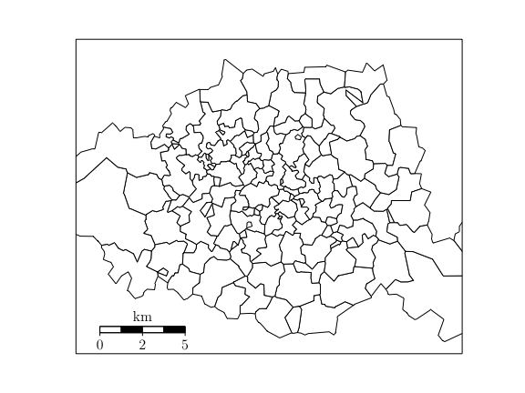
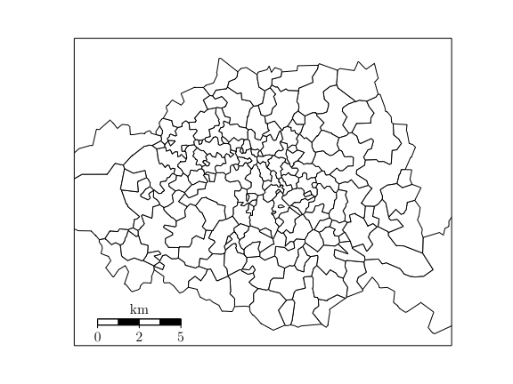
Performance evaluation
17
Privacy GOAL 2:
if 1 ≤ m ≤ 4: 20^{m}-anonymity with prob. 1
if 5 ≤ m ≤ 11, 20^{m}-anonymity with prob. p
p=.99
Original:
p=.999
Notes:
- arbitrary external knowledge => Perfect if data is shared to the public!

Slide 18
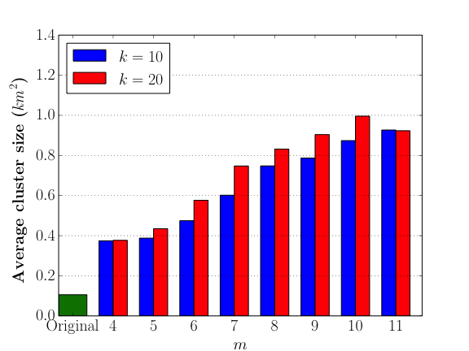
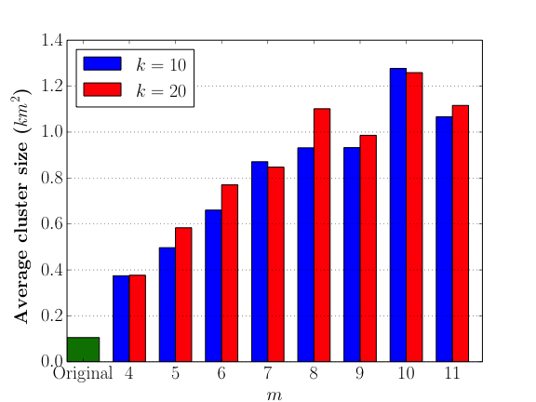
Average partition size
18
  Average territory of the aggregated cells
p = .99
p = .999
Notes:
- arbitrary external knowledge => Perfect if data is shared to the public!

Slide 19
Conclusions
19
k^{m}-anonymity is guaranteed with certain confidence
  Adversarial knowledge is limited to any m items
  Probabilistic relaxation improves scalability and utility
  Proposed anonymization to achieve this guarantee
    Running time is polynomial in m, dataset size, and universe size
  Is it enough? If so, how to choose k, m, p?
    Perform Privacy Risk Analysis

Slide 20
Thank You!
20
Q (&A)

Slide 21
MCMC for sampling m-itemsets
Start with any existing m-items in the dataset.
REPEAT
1. PROPOSAL:
1.1 sample a user uniformly at random
1.2 select m items C from this user also uniformly at random
2. PROBABILISTIC ACCEPTANCE:
2.1 accept it (i.e., S=C) with a probability, which is
min(1, Pr[“S is proposed”]/Pr[“C is proposed”])
UNTIL Convergence
Notes:
The main idea is that, at each state, we use the fast but biased sampling technique to propose a candidate C.
We correct this bias probabistically; M is more likely to accept the samples which are less likely to be proposed.

Slide 22
European Data Protection law
22
personal data is any information relating to an identified or identifiable individual
  can be used to identify him or her, and to know his/her habits
  account must be taken of all the means available […] to determine whether a person is identifiable
any processing of any personal data must be (1) transparent (to the individual), (2) for specified explicit purpose(s), (3) relevant and not excessive in relation to these purposes
Legally nonbinding: all member states have enacted their own data protection legislation
Anonymized data is considered to be non-personal data, and as such, the directive does not apply to that

