Slide 1


MyTrackingChoices:
Pacifying the Ad-Block War by Enforcing User Privacy Preferences
Jagdish Prasad Achara
Joint work with
Javier Parra-Arnau and Claude Castelluccia
WEIS, 2016
University of California, Berkeley

Slide 2
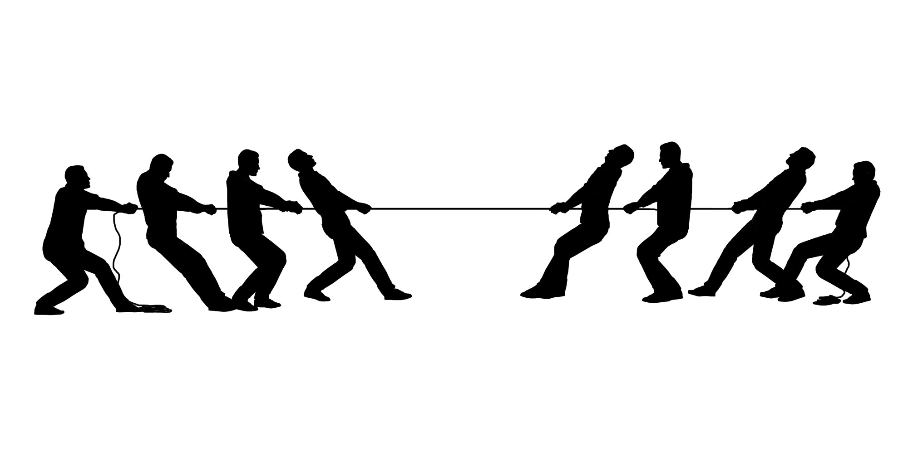
Ad-supported economic model of the Web
is under threat today!
publishers
(ad industry)
users
(ad blocking software)
AdBlock War
Notes:
The reasons behind this AdBliock war lies in the answer to this question…
https://blogs.harvard.edu/vrm/2015/09/21/a-way-to-peace-in-the-adblock-war/

Slide 3


Why ad-supported economy in danger
  intrusive and annoying ads
  privacy-invasive ads
  ads are a source of malware
  ads slow down the page loading
  network bandwidth consumption
  etc.
  users were provided with radical tools
  i.e., tools that block ALL ads
basically, all the reasons
why people started to
block ads in the first place
1
2
Notes:
Such tools did not consider the social and economic benefits of non-intrusive and rational advertising.

Slide 4




Efforts for economic revival
various self-regulatroy initiatives
  Acceptable Ads
  L.E.A.N. program
  YourOnlineChoices
  YourAdChoices
  DNT
tools with some fine-grained options for users
  users can white-list or black-list trackers (advertisers)
  users can white-list or black-list a domain
Notes:
https://acceptableads.org/
http://www.iab.com/news/lean/
http://www.youronlinechoices.eu/
http://youradchoices.com/
http://donottrack.us/

Slide 5
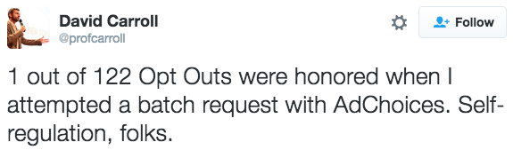
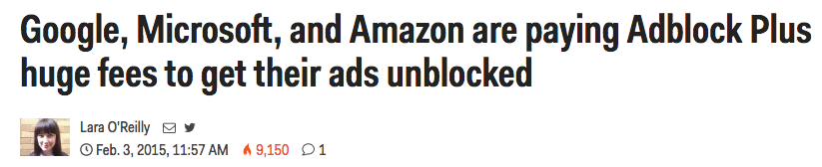
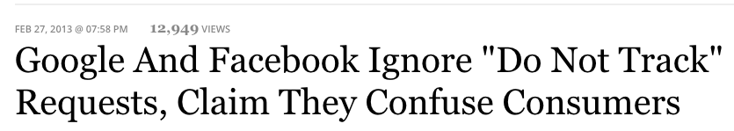
Self-regulatory initiatives do not work
Lack of technical enforcement is the root problem!

Slide 6
Current fine-grained options
not usable
blocking based on third-party
or
blocking on per domain basis
do not make sense from user perspective
(users only care about their browsing profile)

Slide 7
Our approach
technical enforcement of user choices
  should not rely on self-regulation
fine-grained options over the reasons why people block ads
  that are usable and do make sense for users
has the potential to revive ad-supported economic model

Slide 8
Fine-grained options (1)
w.r.t. privacy
  let users decide where they’re ok or not to get tracked
Profile | Allowed?
Adult | ✖
Sports | ✔
Health | ✖
Economy | ✔
… | …
users would be
able to control
the profile
trackers have
(Do not) Track Me Sometimes: Users’ Contextual Preferences for Web Tracking, PETS, 2016
Notes:
users can receive ads targeted to interest categories they want
Answer here the questions that why a user would like to get tarcked at all?
…..answer is: 1. because a user might want to receive ads targeted to some interest categories. 2. if the ad-based economic model of the Web breaks down, users would eventually have to pay to access the content or services and at that time, of course, some users may find it a good compromise.
A recent survey [1] also confirms users’ willingness to have such a feature.

Slide 9
Fine-grained options (2)
w.r.t. intrusiveness
  maximum number of ads per page (on pages where users are ok to be tracked)
  type, size, placement of ads

Slide 10
MyTrackingChoices (MTC)
Notes:
as part of the privacy community, why are we interested in the unicity?

Slide 11
MyTrackingChoices
fine-grained options over privacy (tracking)
Key working assumption
some categories (adult, health, etc.) are more privacy-sensitive than others (sports, fashion)
an attempt to find a trade-off between privacy and economy

Slide 12
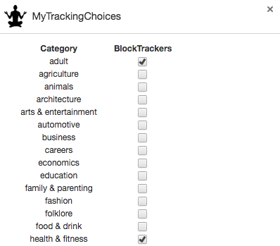

Slide 13
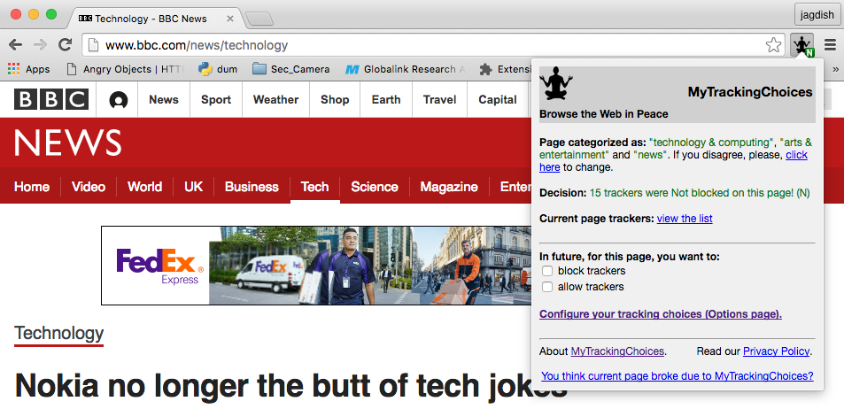
categories
decision

Slide 14
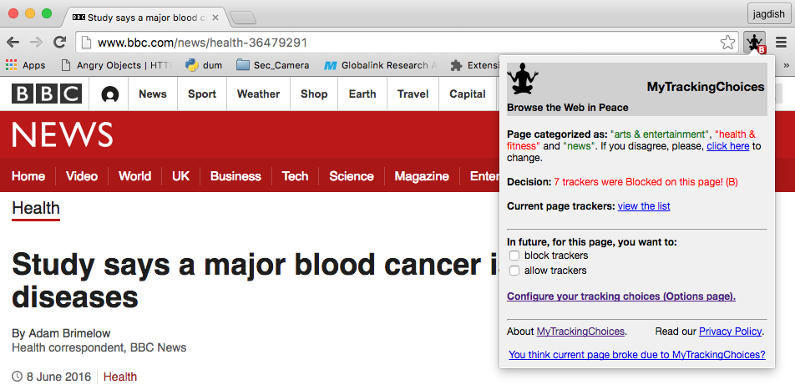
category
decision

Slide 15
Categorization
per web page basis (≠ per domain)
  Benefits
  website: ads would be blocked only on sensitive-category web pages (most revenue preserved)
  user: can technically control his profile yet continue receiving free content
A page is categorized locally based on
  domains/subdomains/hostname
  unigrams and bigrams

Slide 16
Can MTC pacify the Ad-Block War?
Notes:
as part of the privacy community, why are we interested in the unicity?

Slide 17


Ad-Block War
Ad tech
Ad Blocking
tech
Publishers
Users

Slide 18
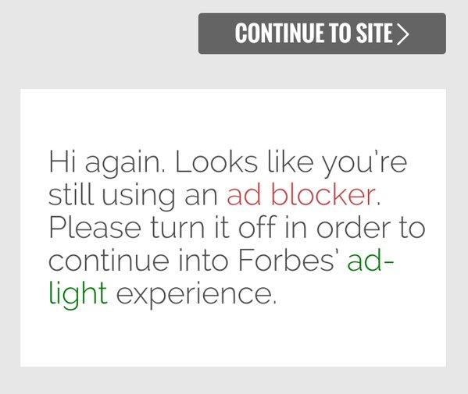
Ad-Block War
[1] Adblocking and Counter-Blocking: A Slice of the Arms Race, arxiv, 2016
[2] A First Look at Ad-Block Detection – A New Arms Race on the Web, arxiv, 2016

Slide 19
Evaluation of data from MTC users
Notes:
as part of the privacy community, why are we interested in the unicity?

Slide 20
Dataset
96 users
  who browsed 20 or more web pages and configured, at least, once their tracking options
  found the extension on Chrome Web Store independently or through various publicity channels
From January 11 to February 20, 2016

Slide 21
Blocked categories
Other economic models needed!
More users blocked sensitive categories
30% users blocked all categories!

Slide 22
Distribution Blocked/Allowed URLs
In total, only 33.19% of browsed
web pages were blocked.
Notes:
In total, only 33.19% of browsed web pages were blocked.

Slide 23
Distribution Blocked/Allowed Ads
23.8% ads were blocked overall.
2015 loss (21.8 → 5.18 billion)
Notes:
In total, only 23.8% ads were blocked.

Slide 24
Conclusions
give users fine-grained control over the reasons why they started to block ads
  win-win situation for all stakeholders
provide users with tools that technically enforce their choices (no self-regulation!)
  such efforts have the potential to pacify the current ad-block war

Slide 25
TODOs
provide users with fine-grained control w.r.t. intrusiveness
make MyTrackingChoices a real product (and not just research prototype)

Slide 26
Announcements
Please download, use, and give feedback on MTC for Google Chrome https://chrome.google.com/webstore/detail/mytrackingchoices/fmonkjimgifgcgeocdhhgbfoncmjclka?hl=fr
Mozilla Firefox version coming soon!

Slide 27
Thanks for your attention!
Questions?
Project web page: https://myrealonlinechoices.inrialpes.fr
Watch on YouTube: https://youtu.be/mzB1hXhqYBE

