Slide 1
On the Unicity of Smartphone Applications
Jagdish Prasad Achara^{Speaker}
Gergely Acs
Claude Castelluccia
INRIA, France

Slide 2
Previous studies
Visited locations are unique
  Unique in the Crowd: The privacy bounds of human mobility,
  Nature Scientific Report, 2013
Credit card metadata is unique
  On the Re-identifiability of credit card metadata,
  Science, 2015

Slide 3
Why we are interested in Unicity?
Notes:
as part of the privacy community, why are we interested in the unicity?

Slide 4
Release of pseudo-anonymized dataset
Rec # | Data
1 | {Item 2, Item 3, Item 8, …, Item M}
2 | {Item 1, Item 13, …, Item N}
… | …
What is the risk of Re-identification of users?

Slide 5
Measuring Re-identification risk
Unicity(2 items in D1) = 8/9 Unicity(2 items in D2) = 6/9
Re-identification risk ≈ Unicity of K-items
Dataset D1
Dataset D2
Rec # | Data
1 | {Item 2, Item 3, Item 8, Item 6}
2 | {Item 1, Item 4}
3 | {Item 2, Item 4, Item 6}
Rec # | Data
1 | {Item 2, Item 3, Item 8, Item 6}
2 | {Item 2, Item 3, Item 7, Item 6}
3 | {Item 2, Item 3, Item 1}
Notes:
Unique, i.e., exists in a single user in the datset
Intuition: more unique the subset of items are, more the risk of re-identification

Slide 6
How to measure Unicity of K-items?

Slide 7
Unicity Measurement
Prohibitively expensive to calculate,
sampling as rescue.
Rec # | Data
1 | {Item 2, Item 3, Item 8, …, Item M}
2 | {Item 1, Item 13, …, Item N}
… | …

Slide 8
How to sample?
Naïve technique:
  Randomly select a user having ≥ K items
  Randomly select K-items from that user
Rec # | Data
1 | {Item 4, Item 5, Item 8, Item 11}
2 | {Item 8, Item 6, Item 11}
3 | {Item 5, Item 7}
4 | {Item 1, Item 11, Item 8}

Slide 9
How to sample?
Naïve technique:
  Randomly select a user having ≥ K items
  Randomly select K-items from that user
Also state-of-the-art technique
  Unique in the Crowd: The privacy bounds of human mobility,
  Nature Scientific Report, 2013
  On the Re-identifiability of credit card metadata, Science, 2015

Slide 10
How to sample?
Naïve technique:
  Randomly select a user having ≥ K items
  Randomly select K-items from that user
Biased towards selecting more popular items!

Slide 11
How to sample?
State-of-the-art technique is biased!
Example:
  Probability(Items 8, 11 are selected) = ¾*⅙
  Probability(Items 5, 7 are selected) = ¼*⅙
Rec # | Data
1 | {Item 4, Item 5, Item 8, Item 11}
2 | {Item 8, Item 6, Item 11, Item 13}
3 | {Item 5, Item 7, Item 2, Item 3}
4 | {Item 1, Item 11, Item 8, Item 12}

Slide 12
How to uniformly sample?
Naïve approaches are inappropriate
  Rejection sampling
  Enumerate all possible combinations of K-apps and find their support in the dataset
Worst-case complexity is exponential in K

Slide 13
Proposed uniform sampling technique
Based on Metropolis-Hastings algo
  A Markov Chain Monte Carlo (MCMC) method
We construct an ergodic Markov chain (M)
  Such that its stationary distribution is uniform
Every possible K-items represent a state of M
  Simulate M until it gets close to uniform

Slide 14
Proposed uniform sampling technique
MCMC sampling algorithm (M):
Start with any existing K-items in the dataset.
REPEAT
1. PROPOSAL:
1.1 sample a user uniformly at random
1.2 select K-apps C from this user also uniformly at random
2. PROBABILISTIC ACCEPTANCE:
2.1 accept it (i.e., S=C) with a probability, which is
min(1, Pr[“S is proposed”]/Pr[“C is proposed”])
UNTIL Convergence
Notes:
The main idea is that, at each state, we use the fast but biased sampling technique to propose a candidate C.
We correct this bias probabistically; M is more likely to accept the samples which are less likely to be proposed.

Slide 15
Proposed uniform sampling technique
Mixing time: roughly the order of dataset size
  Real convergence much smaller for our dataset
Overall Worst-case complexity
  |D| is dataset size
  H is the unicity of K-apps from the largest record of D
Notes:
Our sampling technique remains reasonably fast even for larger values of K.
Detected using Geweke diagnostic

Slide 16
Unicity of K-Apps

Slide 17

Dataset
Comes from Carat research project [1]
Contains list of installed Apps of users
54,893 Android users
92,210 apps
Collected over a period of 7 month
[1] http://carat.cs.helsinki.fi

Slide 18
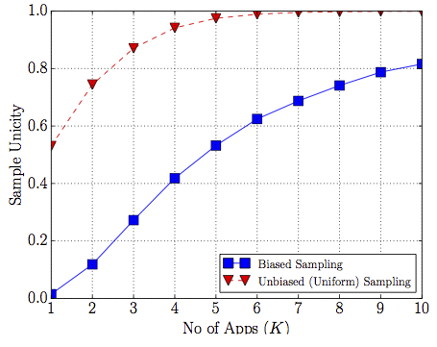
Results
  Unique in the Crowd: The privacy bounds of human mobility,
  Nature Scientific Report, 2013
  On the Re-identifiability of credit card metadata,
  Science, 2015
Notes:
Add the references when I talk about them.

Slide 19
Parties knowing Installed Apps
AppStore owners
  Know all installed Apps
Installed Apps themselves
  May know all or a subset
Included libraries (Ad, Analytics etc.)
  May know all or a subset
Friends/relatives
  May know a subset
Notes:
Apps installed: Twitter etc.
Ad libraries : Airpush http://blog.mojave.net/2014/06/02/mobile-ad-libraries-create-major-risk-for-enterprise-data/
Also, Ad libraries implicitely know the subset of apps installed by a user in which they are present..
On Android, no permission is required to access this information.
On iOS, there is no direct API call existed but various workaround methods existed but with the iOS 9, all of them seemed to be banned. TO VERIFY.

Slide 20






Installed Apps are Quite Revealing
Reference:
Predicting User Traits from a Snapshot of Apps Installed on a Smartphone,
ACM SIGMOBILE Mobile Computing and Communications Review, 2014
Notes:
User traits such as religion, relationship status, spoken languages, countries of interest, and whether or not the user is a parent of a small children, can be easily predicted from the list of installed apps or even from categories of installed apps on smartphones.

Slide 21
Unicity generalization

Slide 22
Regression analysis
Created datasets of varying sizes and computed the sample Unicity
Assumed Unicity a proper function of dataset size

Slide 23
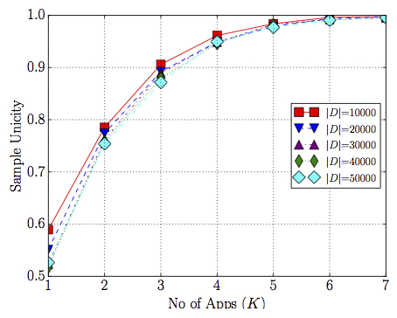
Model selection for regression analysis
where x is the dataset size and f(x) is unicity value

Slide 24
Non-linear regression
Data is divided into 50 parts (size 1K to 50K)
  For training: first 70%
  For testing: last 30%
Training data to learn a, b and c in the model

Slide 25
Unicity Generalization: App Dataset
δ is the avg. absolute error
Notes:
Put it in the backup…

Slide 26
Conclusions
Proposed a method for uniform sampling of K-items
Addressed how Unicity would vary with dataset size
Installed Apps are quite unique

Slide 27
Recommendations
Access to the list of installed apps should be protected on Android
  This is already the case with iOS 9
Extreme care must be taken before releasing pseudo-anonymized installed Apps dataset
  Adversaries do exist

Slide 28
Thanks for your attention!
Questions?

Slide 29
Backup slides

Slide 30
Unicity Generalization: CDR data
δ is average absolute error

